Slide 1


Slide 2

Data Science With Machine Learning

Slide 3
WHAT WE WILL LEARN
What is Data?
Importance of Data in the World?
Use cases of data in the world?
Data Science and Machine Learning ?
Scope of Data Science & Machine Learning?
Why we choose Data Science & machine learning?
Fundamentals of Python.
Life cycle of machine learning and data science project.
Deal with Dataset using python libraries
Training of machine learning algorithm using real world dataset.
Get Prediction from algorithm.

Slide 4

DATA
Data refers to a information, or observations that can be collected, stored, and processed. It can be in the form of numbers, text, images, or any other format. it can reveal patterns, trends, and valuable information that can be used to make informed decisions or draw conclusions.

Slide 5
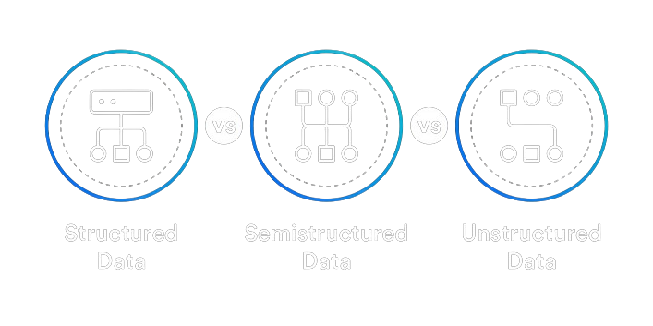
TYPES OF DATA

Slide 6
WHAT CAN DO DATA ?
Decision Making
Scientific Research and Development
Artificial intelligence and Robotics.
Building smart Ai enabled software
IT and other all in industry
Install Ai enabled cameras
Data driven based application
Efficiency and Optimization
Business Analytics
Future estimation.
Content Recommendation

Slide 7



VALUE OF DATA

Slide 8

DATA SCIENCE
Data Science is like being a Detective for information in a world of data. It uses math, computer skills, and knowledge from different areas to find hidden patterns and useful insights in all sorts of information. The main aim is to help people and organization to make smarter decisions , and helps in to run business , and discover new things from data.

Slide 9
SCOPE OF AI & DATA SCIENCE
IT industry
Agriculture Department
Healthcare and Medicine Department
Artificial intelligence and Robotics
Finance and Banking
Marketing and Advertising
Manufacturing and Industry
Transportation and Logistics
E-commerce
And so on…….

Slide 10
Top 10 Highest Paid Jobs in IT Sector in 2024 Data
Data Scientist
DevOps Engineer
Big Data Engineer
Machine Learning Engineer
AI/ML Architect
IoT Solutions Architect
Cloud Architect
Blockchain Developer
Full Stack Developer
AR/VR Developer

Slide 11
Why we choose Data Science & machine learning?
Career Opportunities
Versatility Across Industries
High Demand and Job Opportunities
Competitive Salaries and Career Growth

Slide 12
JOB PROFILES
Data Scientist
Data Analyst
Machine Learning Engineer
Python Developer
Database Administrator
Business Intelligence (BI) Analyst
Data Engineer
Statistician expert Engineer
Quantitative Analyst
Research Scientist
AI/ML Researcher

Slide 13
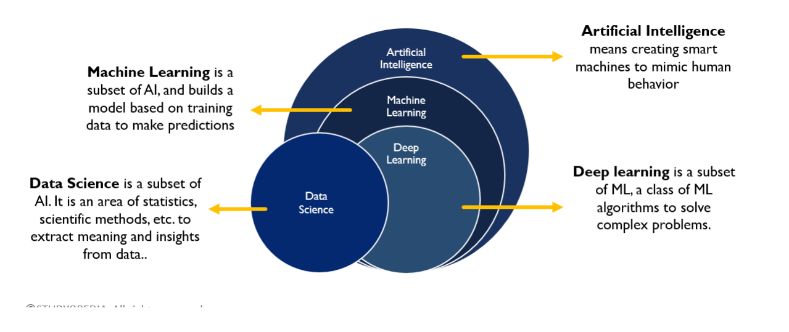
DATA SCIENCE

Slide 14
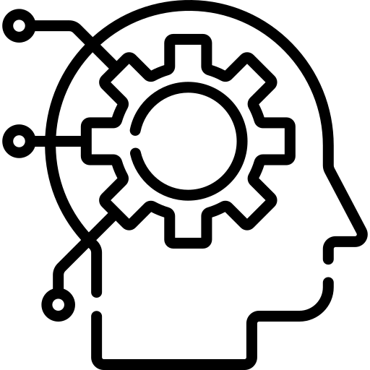
MACHINE LEARNING
Machine learning is a subfield of artificial intelligence (AI) that focuses on the development of algorithms and statistical models that enable computer systems to perform tasks without explicit programming. ML Algorithms learns patterns from the examples of task, to solve that particular task.
The primary goal of machine learning is to allow computers to learn and improve their performance on a specific task as they are exposed to more data over time.

Slide 15
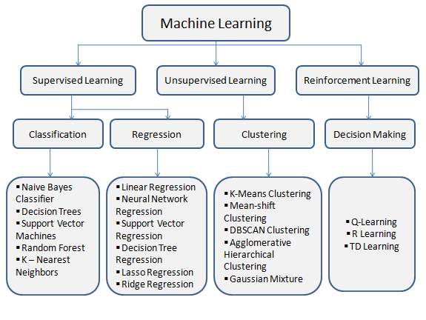
PARTITION OF MACHINE LEARNING

Slide 16
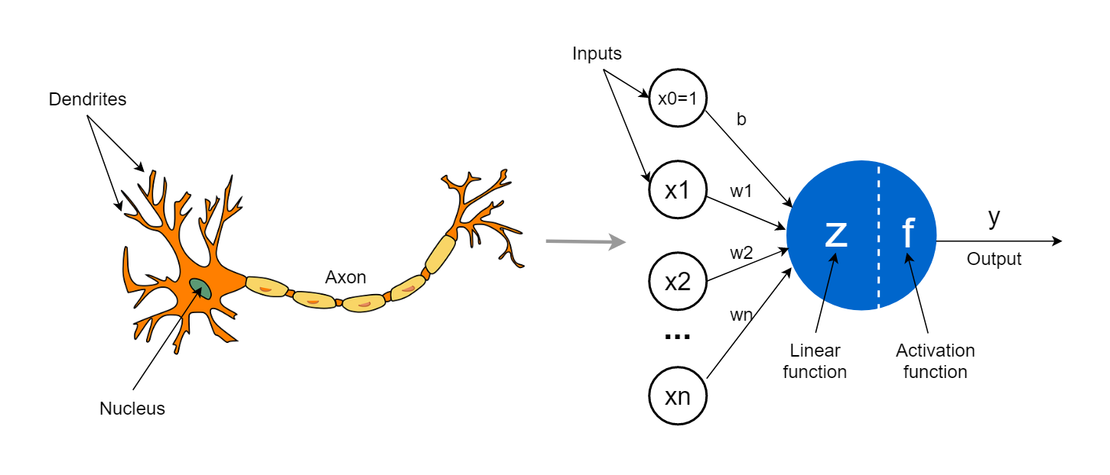
DEEP LEARNING
Deep Learning is a powerful subset of machine learning that involves training of Artificial Neural Networks to perform tasks, Deep learning simulates our brain. it is inspired by biological neuron concepts.

Slide 17

CONNECT ON INSTAGRAM

Slide 18

FEEDBACK FORM

Slide 19
THANK YOU
😊

